Slide 1


Anomalies! You can’t escape them
Sevvandi Kandanaarachchi
R-Ladies Melbourne
September 16 2021

Slide 2

Suppose
After years of scanning the skies we find intelligent life on a planet far, far, away . . .
This is an anomaly. A very interesting anomaly . . . .
We want to know about this anomaly.
What kind of life forms?
What kind of technology?
Do they use Maths and Stats?

Slide 3


Why anomalies?
They tell a different story
Fraudulent credit card transactions amongst billions of legitimate transactions
Computer network intrusions
Astronomical anomalies – solar flares
Weather anomalies – tsunamis
Stock market anomalies – heralding a crash?

Slide 4
Anomaly detection – why?
Take fraud and network intrusions for example
Training a model on certain fraud/intrusions/cyber attacks is not optimal, because there are new types of fraud/attacks, always!
You want to be alerted when weird things happen.
Anomaly detection is used in these applications.

Slide 5
Overview
Introduction
Unsupervised Anomaly Detection (AD)
Evaluating AD methods
How to compare 2 methods
Data repositories
New Research
AD ensemble method using Item Response Theory
Preprint - https://arxiv.org/abs/2106.06243

Slide 6
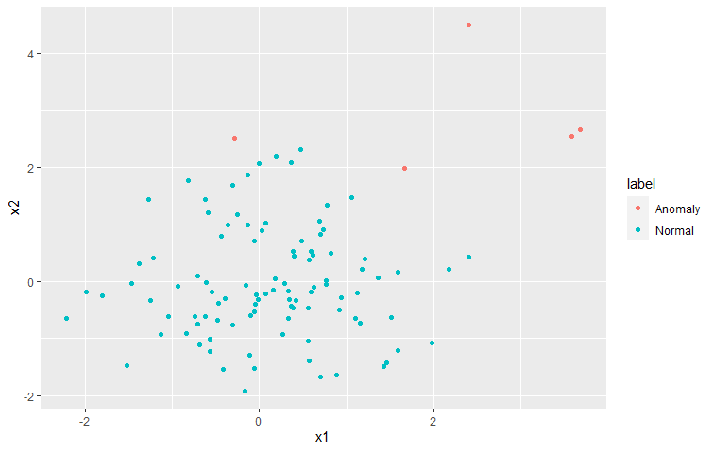
Unsupervised Anomaly Detection
Hawkins (1980) – “an outlier/anomaly is an observation which deviates so much from the other observations as to arouse suspicions that it was generated by a different mechanism”
Need to detect the anomalies

Slide 7
Many, many AD methods . . .
Many research communities have been interested in anomaly/outlier detection
Statisticians
Computer Scientists (traditional)
Machine Learning community
Statistical/machine learning methods
Nearest neighbour/density based/clustering methods
Deep learning/reconstruction based methods/dimension reduction
Parametric/non-parametric

Slide 8
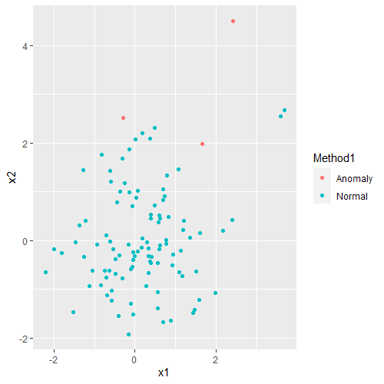
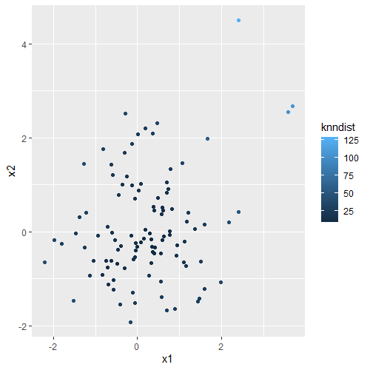
Identify or give a score?
Identify anomalies (HDoutliers)
Give anomaly scores (DDoutlier)

Slide 9
Identify or give a score?
Identify
Traditionally Statisticians
Which point is most outlying? - without a score it is hard to tell
Give scores
Traditionally Computer scientists
Then the user needs to specify a threshold
Recent methods have both
They give scores as well as a threshold to identify outliers

Slide 10
Evaluating AD methods
Why traditional accuracy doesn’t work?
Of 5 anomalies we’ve missed 2
Accuracy = 103/105
But if no anomalies are detected
Accuracy = 100/105
Accuracy is still very high
You need other evaluation methods for imbalanced datasets

Slide 11
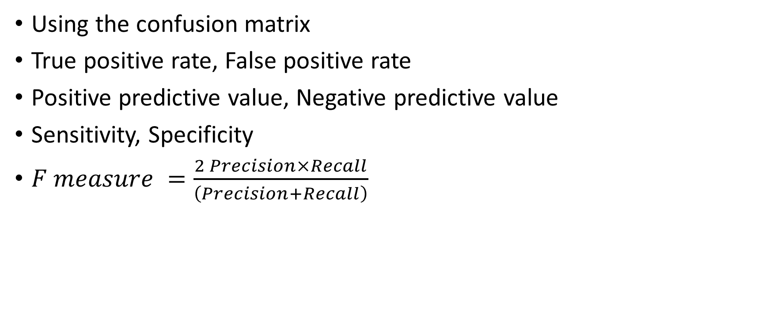
Evaluation methods – if you identify
Using the confusion matrix
True positive rate, False positive rate
Positive predictive value, Negative predictive value
Sensitivity, Specificity
$F measure =\frac{2 Precision×Recall}{\left(Precision+Recall\right)}$
 | Predicted Yes | Predicted No
Actual Yes | True Positives | False Negatives
Actual No | False Positives | True Negatives

Slide 12
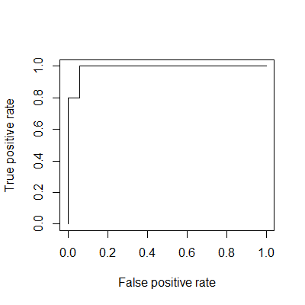
Evaluation methods – if you give scores
Area Under ROC curve
TPR vs FPR
Area Under PR curve
Precision vs Recall
Higher the area, better the AD method

Slide 13
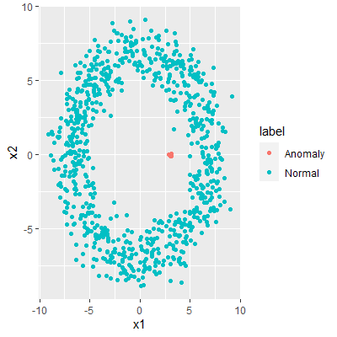
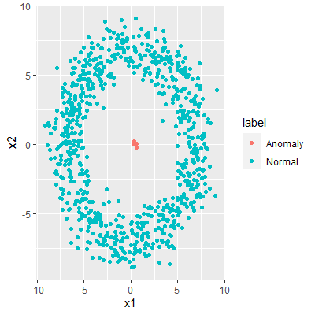
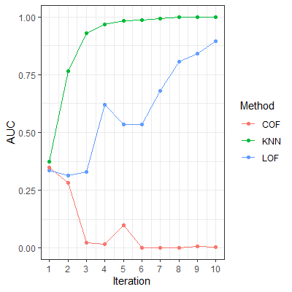
Compare two/more methods
Iteration 5
Iteration 10
Area Under ROC

Slide 14
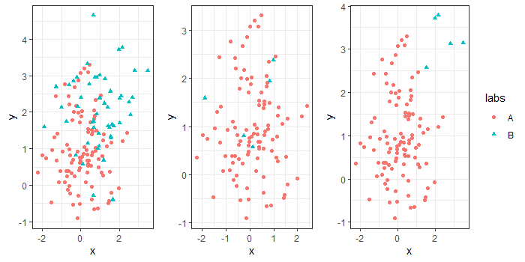
What about real datasets?
Classification datasets (two or more classes)
Downsample the minority class and designate these as anomalies
Many downsampled datasets from the same source
Evaluate methods on such datasets

Slide 15
AD Data Repositories
KMASH data repository - https://researchdata.edu.au/kmash-repository-outlier-detection/1733742
ODDS data repository - http://odds.cs.stonybrook.edu/
ELKI - https://elki-project.github.io/datasets/outlier
Harvard Dataverse AD datasets - https://dataverse.harvard.edu/dataset.xhtml?persistentId=doi:10.7910/DVN/OPQMVF
ADRepository - https://towardsdatascience.com/adrepository-anomaly-detection-datasets-with-real-anomalies-2ee218f76292
AD Metaanalysis Benchmarks - https://ir.library.oregonstate.edu/concern/datasets/47429f155

Slide 16
Anomaly Detection Ensembles

Slide 17
Why ensembles?
AD has many applications
How do we better identify anomalies
Better methods
Ensembles – use existing methods to come up with better anomaly detection/scores

Slide 18
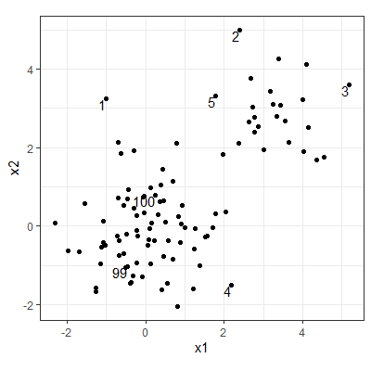
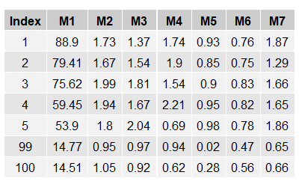
What is an anomaly detection ensemble?
Dataset
Unsupervised AD methods
AD ensemble
Ensemble Score
The AD methods are heterogenous methods

Slide 19
Other types of AD ensembles are there
Feature bagging
Subsampling methods
Main difference: 1 AD method in feature bagging and subsampling
Dataset
Different subsets/samples
1 AD method
Ensemble Score = Average

Slide 20
To construct the AD ensemble we use Item Response Theory

Slide 21

What is Item Response Theory (IRT)?
A set of models used in psychometrics/social sciences
In education
Find the difficulty and discrimination of test questions
Ability of participants
In social sciences - unobservable characteristics and observed outcomes
Verbal or mathematical ability
Racial prejudice or stress proneness
Political inclinations
Intrinsic “quality” that cannot be measured directly
Latent trait modelling
This Photo by Unknown Author is licensed under CC BY-SA

Slide 22

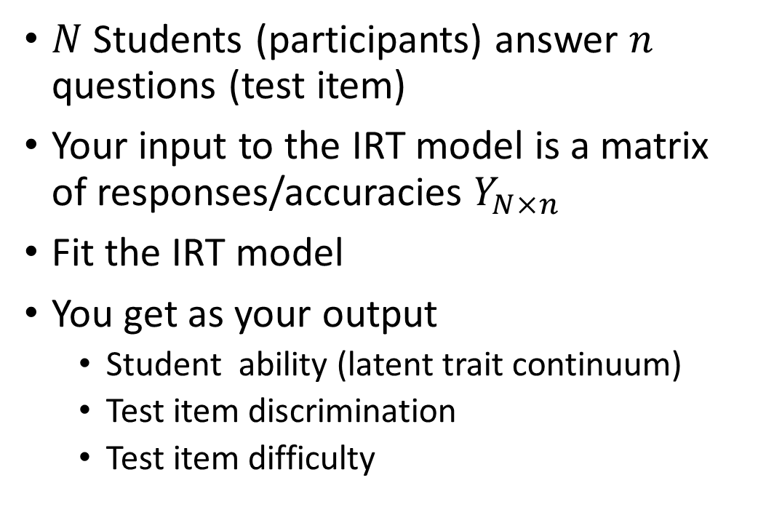
What is IRT?
$N$Students (participants) answer $n$ questions (test item)
Your input to the IRT model is a matrix of responses/accuracies $Y_{N×n}$
Fit the IRT model
You get as your output
Student ability (latent trait continuum)
Test item discrimination
Test item difficulty
 | Q 1 | Q 2 | Q 3 | Q 4
Stu 1 | 0.95 | 0.87 | 0.67 | 0.84
Stu 2 | 0.57 | 0.49 | 0.78 | 0.77
Stu n | 0.75 | 0.86 | 0.57 | 0.45
This Photo by Unknown Author is licensed under CC BY

Slide 23
Different IRT Mappings

Slide 24
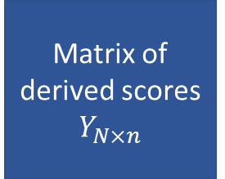
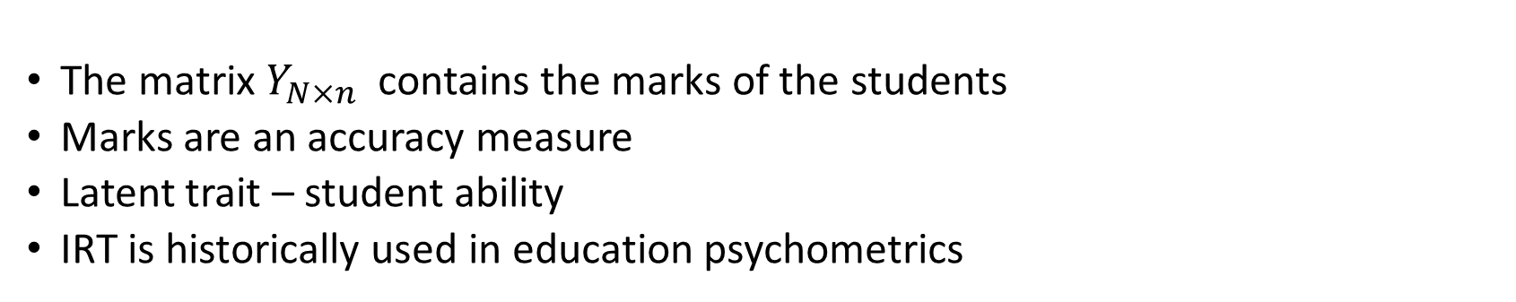
IRT in education
Participant 1
Item 1
Matrix of derived scores $Y_{N×n}$
IRT Model
Participant N
Item n
The matrix $Y_{N×n}$ contains the marks of the students
Marks are an accuracy measure
Latent trait – student ability
IRT is historically used in education psychometrics

Slide 25
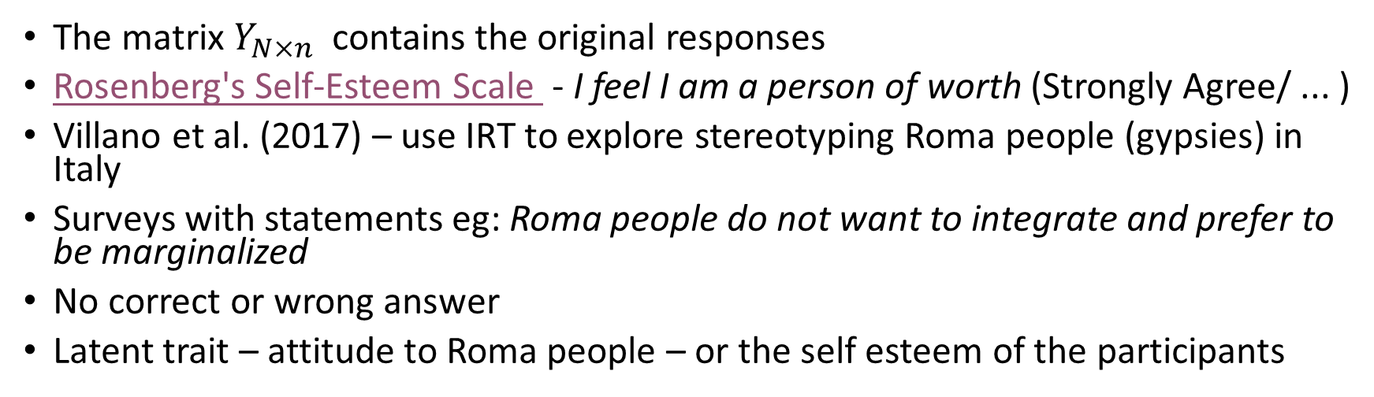
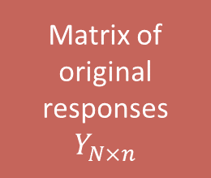
IRT in psychometrics (e.g. racial prejudice)
Participant 1
Item 1
Matrix of original responses $Y_{N×n}$
IRT Model
Participant N
Item n
The matrix $Y_{N×n}$ contains the original responses
Rosenberg's Self-Esteem Scale - I feel I am a person of worth (Strongly Agree/ ... )
Villano et al. (2017) – use IRT to explore stereotyping Roma people (gypsies) in Italy
Surveys with statements eg: Roma people do not want to integrate and prefer to be marginalized
No correct or wrong answer
Latent trait – attitude to Roma people – or the self esteem of the participants

Slide 26

IRT in Machine Learning
First work by Martínez-Plumed et al. (2016, 2019)
Evaluating algorithms
Later preprint with Kate Smith-Miles using IRT in algorithm evaluation (2020)
Preprint - https://bit.ly/algorithmirt
Use IRT to construct an AD ensemble
Preprint - https://arxiv.org/abs/2106.06243

Slide 27
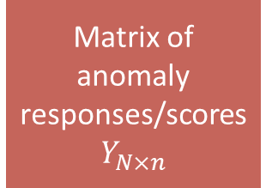
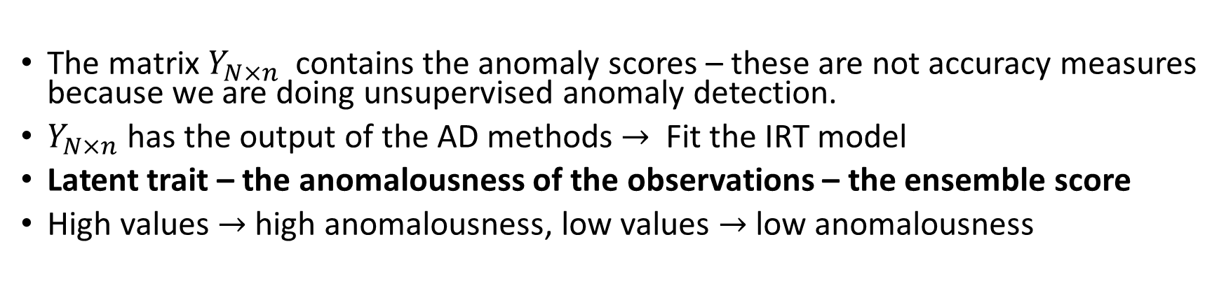
IRT ensemble for anomaly detection
Observation 1
AD method 1
Matrix of anomaly responses/scores $Y_{N×n}$
IRT Model
Observation N
AD method n
The matrix $Y_{N×n}$ contains the anomaly scores – these are not accuracy measures because we are doing unsupervised anomaly detection.
$Y_{N×n}$has the output of the AD methods $→$ Fit the IRT model
Latent trait – the anomalousness of the observations – the ensemble score
High values $→$ high anomalousness, low values $→$ low anomalousness

Slide 28
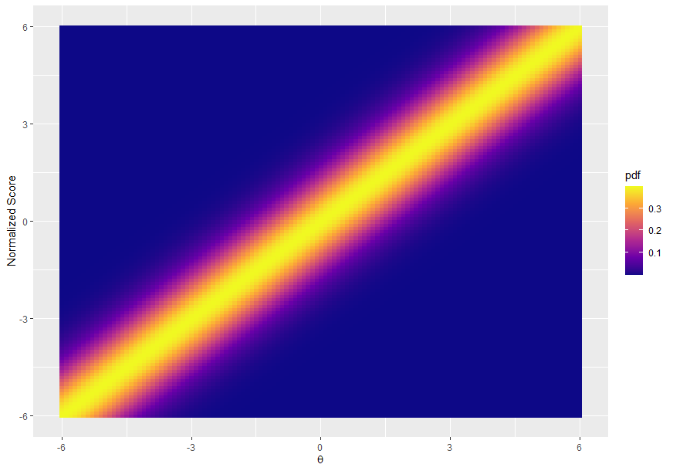
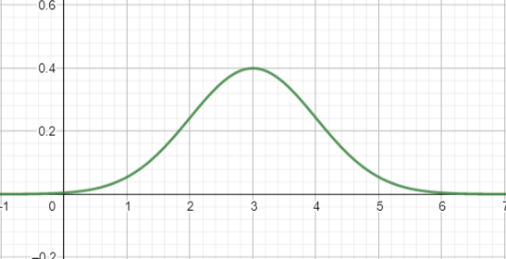
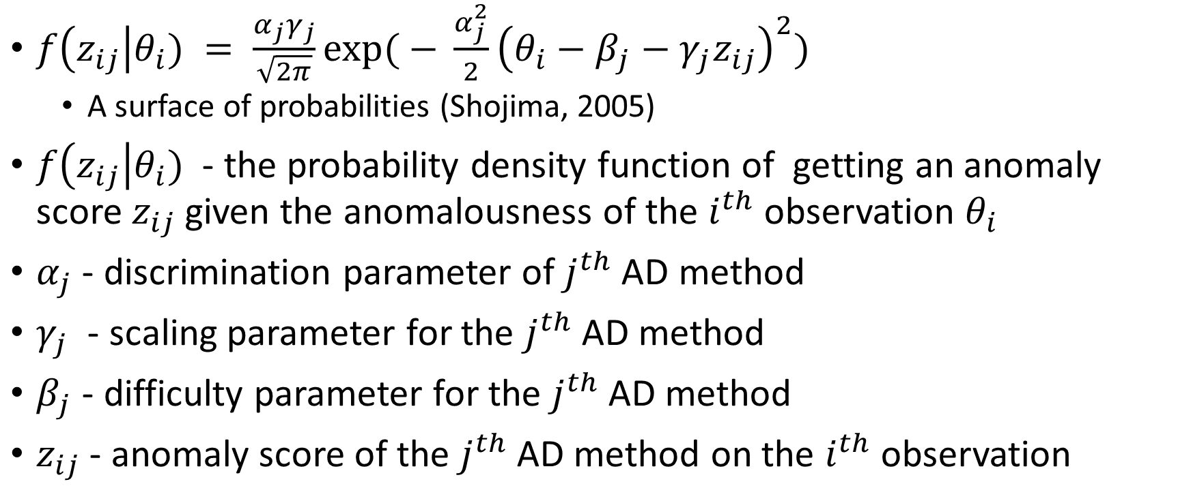
The IRT model
$f\left(z_{ij}\right|θ_{i}) = \frac{α_{j}γ_{j}}{\sqrt{2π}}\exp{( − }\frac{α_{j}^{2}}{2}{\left(θ_{i}−β_{j}−γ_{j}z_{ij}\right)}^{2})$
A surface of probabilities (Shojima, 2005)
$f\left(z_{ij}\right|θ_{i})$ - the probability density function of getting an anomaly score $z_{ij}$ given the anomalousness of the $i^{th}$observation $θ_{i}$
$α_{j}$ - discrimination parameter of $j^{th}$ AD method
$γ_{j}$ - scaling parameter for the $j^{th}$ AD method
$β_{j}$ - difficulty parameter for the $j^{th}$ AD method
$z_{ij}$ - anomaly score of the $j^{th}$ AD method on the $i^{th}$ observation

Slide 29
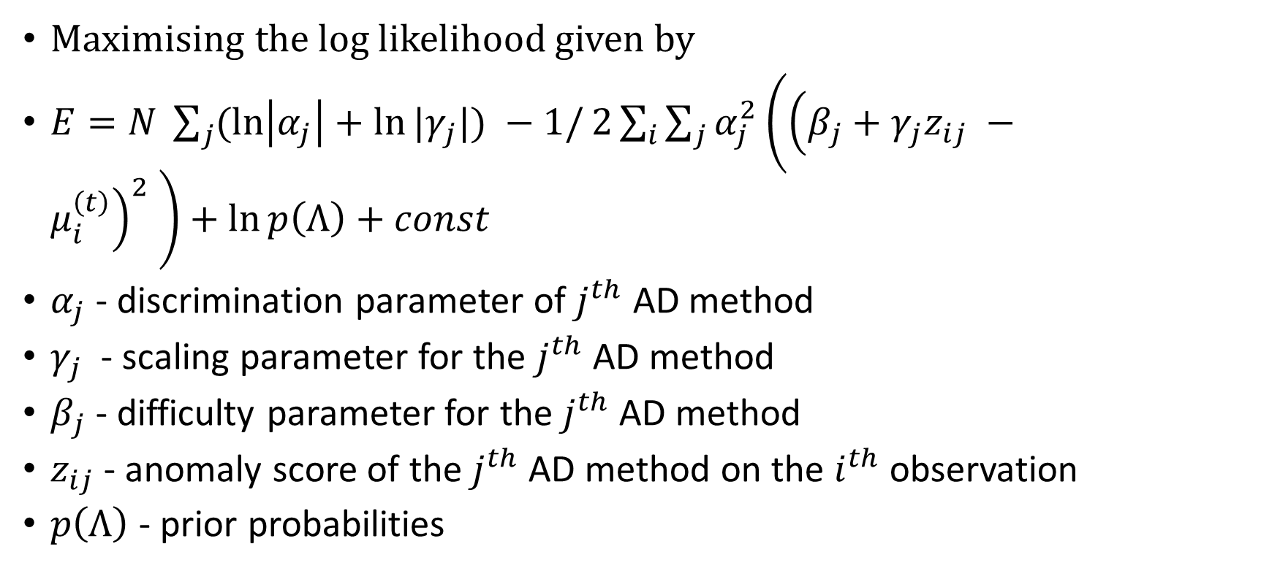
What are we fitting?
Maximising the log likelihood given by
$E=N \sum_{j}{(\ln\left|α_{j}\right|+\ln{|γ_{j}|) −1/}2\sum_{i}{\sum_{j}{α_{j}^{2}\left({\left(β_{j}+γ_{j}z_{ij} −μ_{i}^{\left(t\right)}\right)}^{2} \right)+\ln{p\left(Λ\right)+const}}} }$
$α_{j}$ - discrimination parameter of $j^{th}$ AD method
$γ_{j}$ - scaling parameter for the $j^{th}$ AD method
$β_{j}$ - difficulty parameter for the $j^{th}$ AD method
$z_{ij}$ - anomaly score of the $j^{th}$ AD method on the $i^{th}$ observation
$p\left(Λ\right)$ - prior probabilities

Slide 30
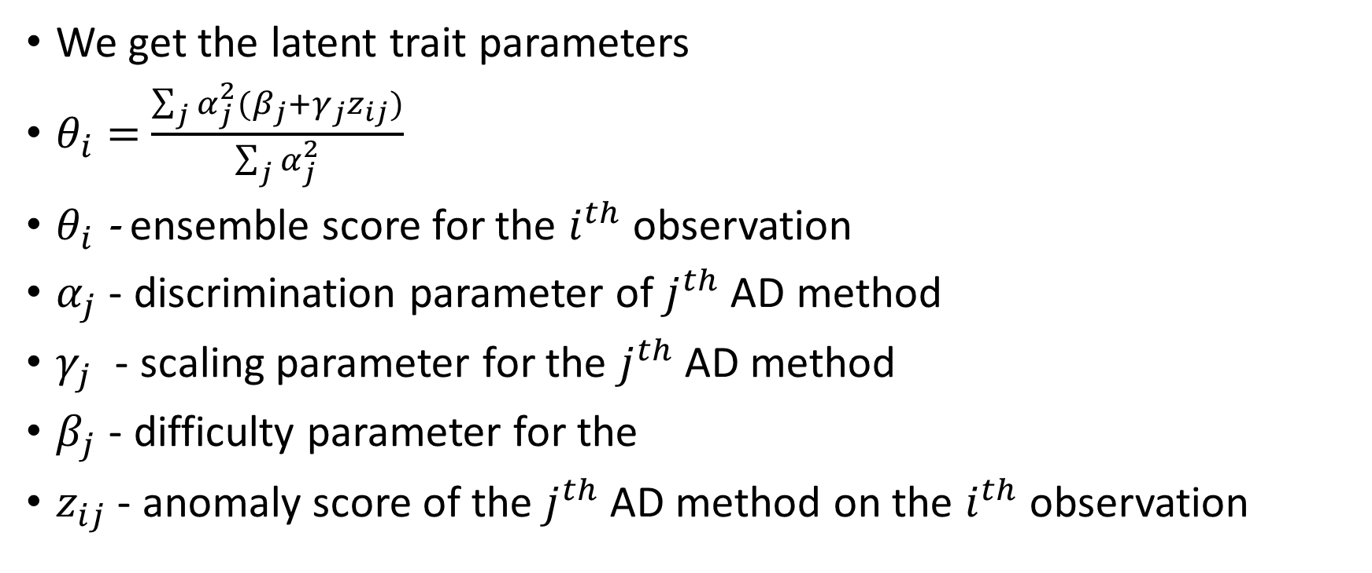
And the ensemble scores . . .
We get the latent trait parameters
$θ_{i}=$ $\frac{\sum_{j}{α_{j}^{2}(β_{j}+γ_{j}z_{ij})}}{\sum_{j}{α_{j}^{2}}}$
$θ_{i}$ - ensemble score for the $i^{th}$ observation
$α_{j}$ - discrimination parameter of $j^{th}$ AD method
$γ_{j}$ - scaling parameter for the $j^{th}$ AD method
$β_{j}$ - difficulty parameter for the
$z_{ij}$ - anomaly score of the $j^{th}$ AD method on the $i^{th}$ observation

Slide 31
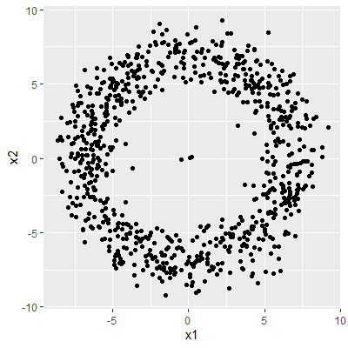
Example 1
Dataset
Unsupervised AD methods
AD ensemble
Ensemble Score
AD methods (DDoutlier, h2o, e1071)
KNN_AGG
LOF
COF
INFLO
KDEOS
LDF
LDOF
Autoencoders – Deep learning
OCSVM – One class Support Vector Machine
Isolation Forest – Tree based method
Nearest neighbourhood-based methods
Density/distance based

Slide 32
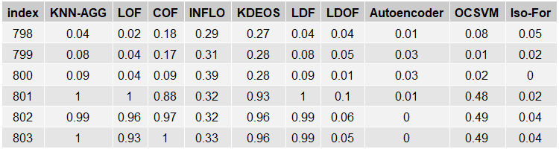
Unsupervised AD methods output

Slide 33
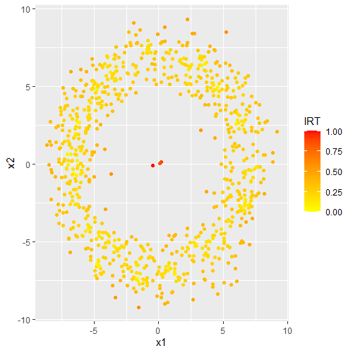

IRT Ensemble
$$Y_{N×n}$$
IRT ensemble
Ensemble Score

Slide 34
Compare with other ensemble methods
Average
Greedy (Schubert et al, 2012)
Greedy Average
ICWA (Chiang et al, 2017)
IRT
Max (Aggarwal and Sathe, 2015)
Threshold (Aggarwal and Sathe, 2015)

Slide 35
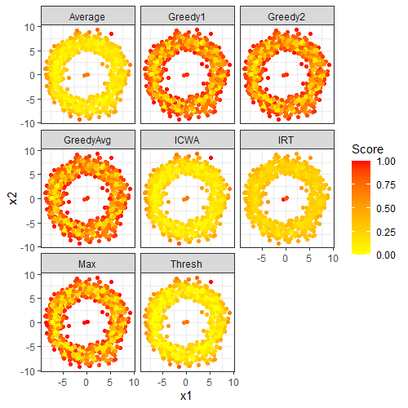
Comparison

Slide 36
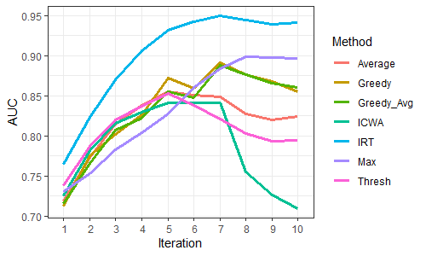
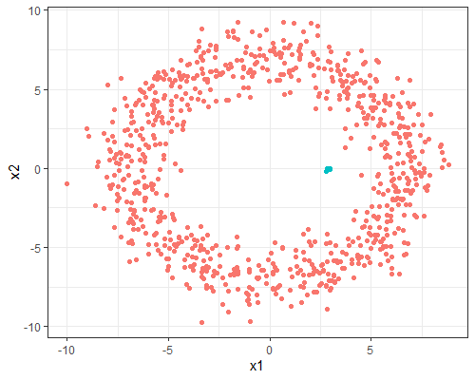
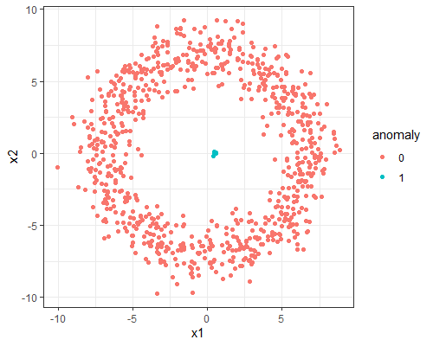
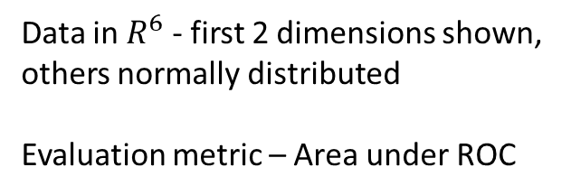
Example with iterations
Data in $R^{6}$ - first 2 dimensions shown,
others normally distributed
Evaluation metric – Area under ROC
Iteration 5
Iteration 10

Slide 37

Summary
Anomaly detection in many applications
IRT – used in social sciences/psychometrics
Use IRT for AD ensembles
Tests of real datasets - good results
More details on the preprint - https://arxiv.org/abs/2106.06243
R package – outlierensembles – on CRAN - extends R package EstCRM for IRT

Slide 38

Preprint - https://arxiv.org/abs/2106.06243
Slides/code - https://github.com/sevvandi/Talks/tree/master/2021-R-Ladies

